Slide 1


AI-Driven Eco-Friendly Email Management for Enhanced Productivity in the Automotive Industry
Annamdas Venu Gopal Madhav, PhD
Notes:
I was previously with the Automotive Industry for a couple of years and with the university for most of the time.

Slide 2
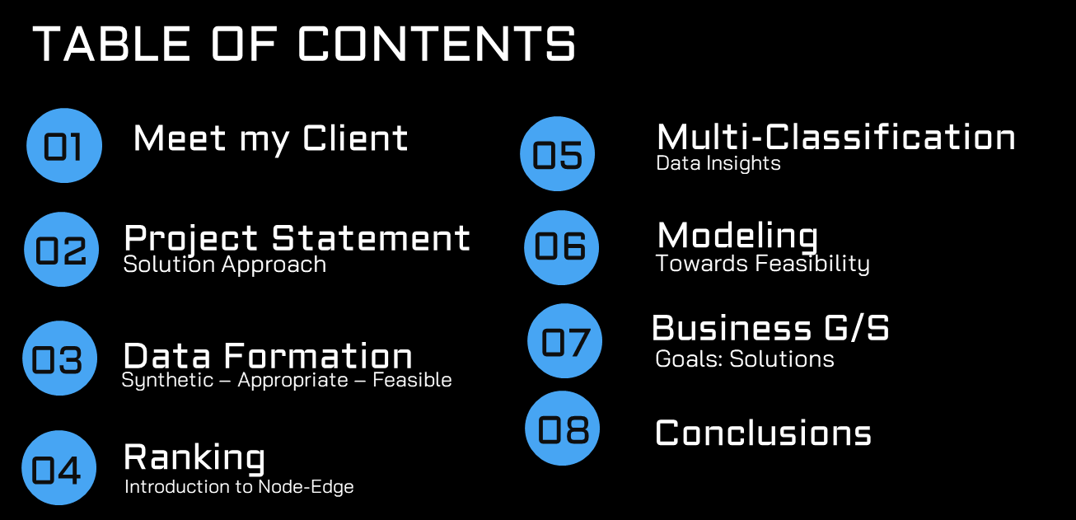
AI-Driven Eco-Friendly Email Management for Enhanced Productivity in the Automotive Industry

Slide 3


AI-Driven Eco-Friendly Email Management for Enhanced Productivity in the Automotive Industry
Ranking
Classification
Business Value: Cost-saving and time-optimized
https://youtu.be/eMWdeP17StA?si=2Ol_jclqmtz6Gj_l

Slide 4
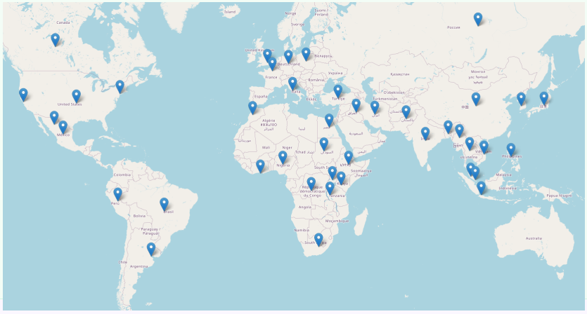
AI-Driven Eco-Friendly Email Management for Enhanced Productivity in the Automotive Industry
Stakeholders:
Dr. David Woon
(Co-Director, Continental Automotive Singapore)
Extendable to Continental Automotive Group
IT Department
Suppliers/Operations Group
Individuals of Nanyang Tech. University, Singapore(alternate)
Total Emp Population: 217600
Total Wastage Cost per Day
31.25% salary
DashBoard Info: raw.githack.com/venuannamdas/E_clean_AI/master/employee_wastage_map.html

Slide 5

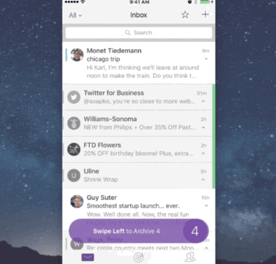
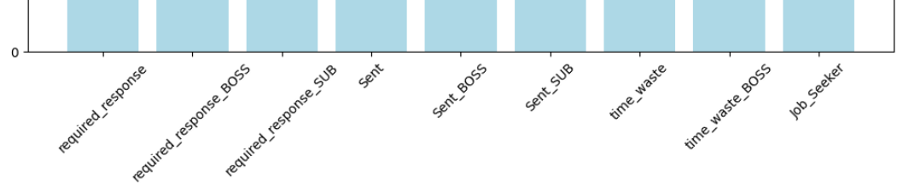
AI-Driven Eco-Friendly Email Management for Enhanced Productivity in the Automotive Industry
Dr. David Woon, is currently grappling with several email management challenges that require immediate attention. The baseline conditions for his email-box status needs improvement especially:, the project will concentrate on the following key objectives:
1) Email Ranking Based on Urgency: Develop on the top of Dr. Woon's inbox.
2) Multi-Classification of Emails: Implement a multi-classification system for emails, categorizing them into distinct labels. This classification will provide a structured approach to email handling.

Slide 6
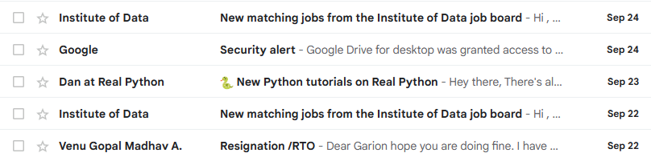
AI-Driven Eco-Friendly Email Management for Enhanced Productivity in the Automotive Industry
Dataset Columns
(10k observations)
To_list', 'From_list','Title', 'subject_list','Date_list', 'Label', 'file'
User
Assumption: synthetic data was adopted for modifications because of the nature of the task assigned. CC, BCC was not considered
Dataset Sources: (basic) https://www.kaggle.com/datasets/wcukierski/enron-email-dataset
Modified: https://raw.githubusercontent.com/venuannamdas/E_clean_AI/master/smartcontinental.csv

Slide 7


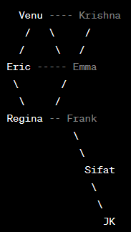
AI-Driven Eco-Friendly Email Management for Enhanced Productivity in the Automotive Industry
Ranking
NetworkX-Python Library
NetworkX
Nodes: Friendship graph
Venu is friends with Eric and Krishna.
Eric is friends with Venu, Emma, and Regina.
Emma is friends with Eric.
Krishna is friends with Venu.
Regina is friends with Eric, Frank, and Sifat.
Frank is friends with Regina and Sifat.
Sifat is friends with Regina, Frank, and JK.
JK is friends with Sifat
Customize

Slide 8
AI-Driven Eco-Friendly Email Management for Enhanced Productivity in the Automotive Industry
To_list', 'From_list', 'Date_list', 'subject_list', 'Title', 'Label', 'file']
required_response: Emails that require a response from David, important
information/requests that need his attention.
required_response_BOSS: These have higher importance, these are from superiors.
David should prioritize
required_response_SUB: Emails from David's subordinates or team members.
David should respond to maintain effective communication
within his team.
Job_Seeker: David may not necessarily need to respond.
Instead, he can forward them to the appropriate department/person/HR
for follow-up.
Multi-classification (Label)
required_response
required_response_BOSS
required_response_SUB
Sent
Sent_BOSS
Sent_SUB
time_waste
time_waste_BOSS
Job_Seeker

Slide 9
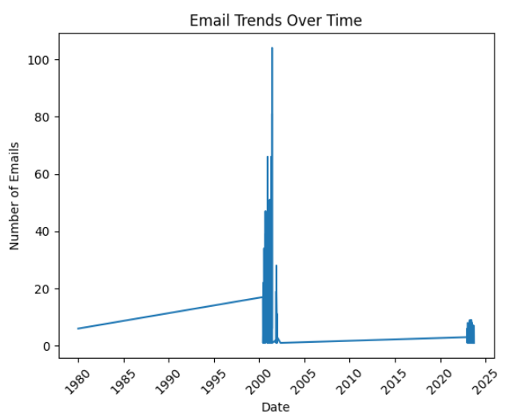
AI-Driven Eco-Friendly Email Management for Enhanced Productivity in the Automotive Industry
EDA- Insights
Enron Emails + Customized: 2000-2005
Synthetic Emails: 2020-2023

Slide 10
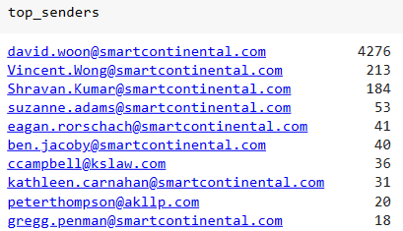
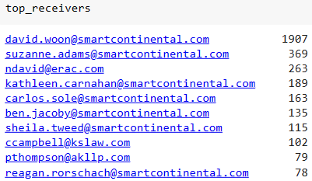
AI-Driven Eco-Friendly Email Management for Enhanced Productivity in the Automotive Industry
The final email-set (Data frame characteristics)

Slide 11
AI-Driven Eco-Friendly Email Management for Enhanced Productivity in the Automotive Industry
From (Domains): David’s 1000’s of Email are coming from these few DOMAINS
'smartcontinental.com', 'erac.com', 'corp.classmates.com', 'casa-de-clarke.com', 'crmems.com', 'airmail.net', 'southwestern.edu', 'wcnet.net', 'gtlaw.com', 'kslaw.com', 'brunini.com', 'jonesday.com', 'paulhastings.com', 'yahoo.com', 'leggefarrow.com', 'deltapower.com', 'watervalley.net', 'ensr.com', 'winston.com', 'nepco.com', 'ss.ps.ge.com', 'akllp.com', 'excitecorp.com', 'pecorp.com', 'andrews-kurth.com', 'tecoenergy.com', 'ps.ge.com', 'citi.com', 'disc-passport.com', 'haysmcconn.com', 'piperrudnick.com', 'bracepatt.com', 'intergen.com', 'llgm.com', 'bingham.com', 'dell.com', 'ae.ge.com', 'kilstock.com', 'rc.com', 'cmates.com', 'amazon.com', 'ssfrancis.org', 'ntls1.digitalriver.com', 'newmn-r1.blue.aol.com', 'us.abb.com', 'fulbright.com', 'bek.com', 'freshfields.com', 'verticalnet.com', 'milbank.com', 'example.net', 'conti_job_portal.com', 'example.com', 'example.org'

Slide 12
AI-Driven Eco-Friendly Email Management for Enhanced Productivity in the Automotive Industry
Time response : time_difference = (current_time - date_received).days
David’s -Urgency list
['soon', 'shortly', 'urgent', 'pressing', 'speedy', 'prompt', 'straightaway', 'fast', 'promptly', 'quick', 'immediate', 'quickly', 'agile', 'ready', 'Vincent', 'vincent']
Baseline : NetworkX
Customized NetworkX
Time response
Time response
Urgency list

Slide 13
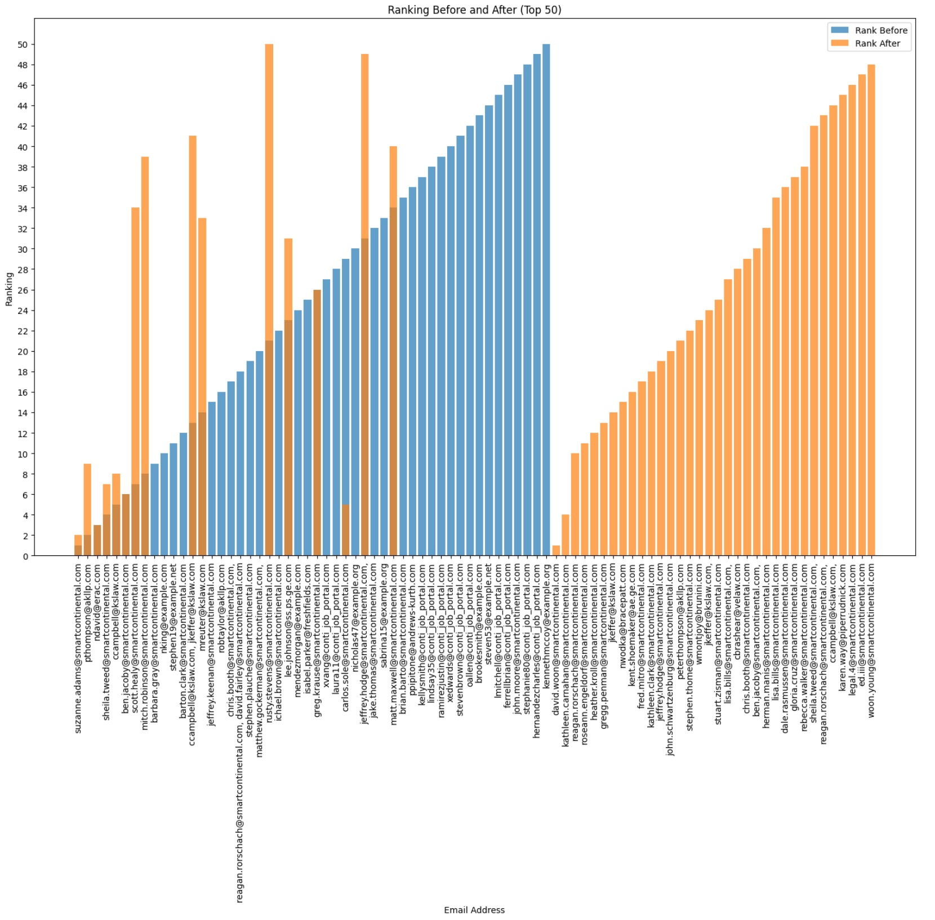
AI-Driven Eco-Friendly Email Management for Enhanced Productivity in the Automotive Industry
Customized NetworkX
Baseline (generic) : NetworkX
70% of the time – looking at the wrong email
https://www.figma.com/file/6CuLnyoTRoE13pmuHykP7E/Email_project?type=whiteboard&node-id=1002-143

Slide 14
AI-Driven Eco-Friendly Email Management for Enhanced Productivity in the Automotive Industry
Customized NetworkX
Baseline (generic) : NetworkX

Slide 15
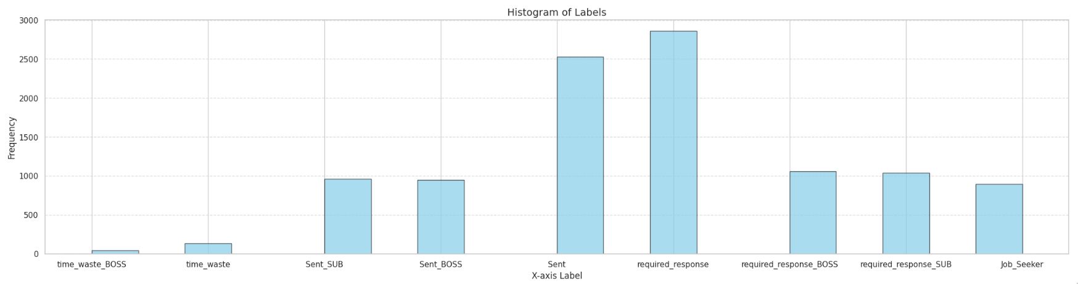
AI-Driven Eco-Friendly Email Management for Enhanced Productivity in the Automotive Industry
Problem: Some observations are very low.
Need to apply binary (YES or NO) for each label separately
Assumption: drop labels which are low.
As synthetic data was adopted because of the nature of the task assigned,
the accuracy, precision, F1 score etc. will be lower

Slide 16
AI-Driven Eco-Friendly Email Management for Enhanced Productivity in the Automotive Industry
Dataset Columns
To', 'From','Title', 'subject_list','Date', 'Label', 'file’ ------
User
Features/independent variables – 5
Dependent variable -1 (Label)

Slide 17
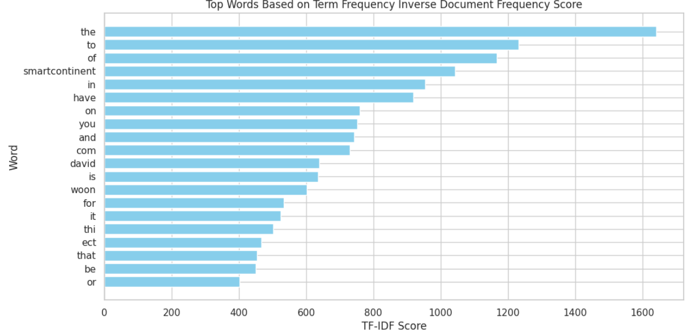
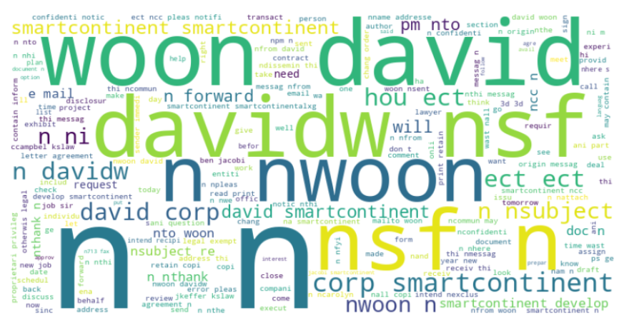
AI-Driven Eco-Friendly Email Management for Enhanced Productivity in the Automotive Industry
Steps: Preprocessing for removing punctuations, an essential step in natural language processing (NLP) tasks was carried out. Porter stemmer was used for removing suffixes. (Natural Language Toolkit library), etc
Word cloud
Notes:
Removing punctuation (Punctuation includes characters like periods, commas, question marks, exclamation points, and other symbols ) can help clean and simplify text data, making it easier to analyze and process. POS tagging was done

Slide 18
AI-Driven Eco-Friendly Email Management for Enhanced Productivity in the Automotive Industry
Output Considered: 5 labels
Models studied:
1 - K-Nearest Neighbors (K-NN) classifier
2 - Support Vector Machine classifier
3 - Forward Neural Network (FNN) classifier
4 - Decision Tree classifier
5 - Random Forest classifier
Notes:
Removing punctuation (Punctuation includes characters like periods, commas, question marks, exclamation points, and other symbols ) can help clean and simplify text data, making it easier to analyze and process

Slide 19
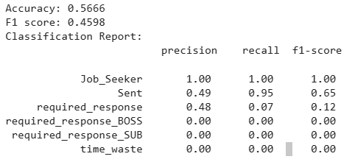
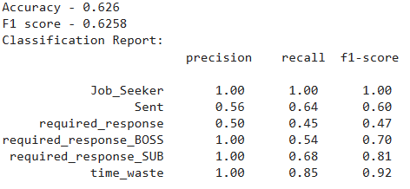
AI-Driven Eco-Friendly Email Management for Enhanced Productivity in the Automotive Industry
1 - K-Nearest Neighbors (K-NN) classifier
2 - Support Vector Machine classifier
Notes:
Removing punctuation (Punctuation includes characters like periods, commas, question marks, exclamation points, and other symbols ) can help clean and simplify text data, making it easier to analyze and process

Slide 20
AI-Driven Eco-Friendly Email Management for Enhanced Productivity in the Automotive Industry
3 - Forward Neural Network (FNN) classifier
To', 'From','Title', 'subject_list','Date', 'Label', 'file’ ------
Notes:
Removing punctuation (Punctuation includes characters like periods, commas, question marks, exclamation points, and other symbols ) can help clean and simplify text data, making it easier to analyze and process

Slide 21
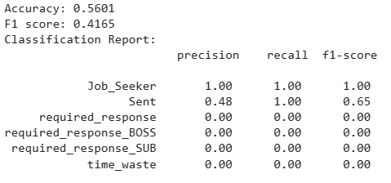
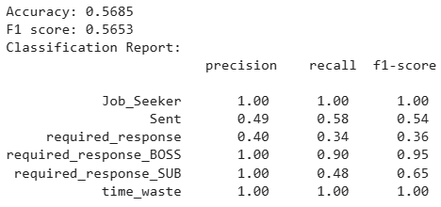
AI-Driven Eco-Friendly Email Management for Enhanced Productivity in the Automotive Industry
4 - Decision Tree classifier
5 - Random Forest classifier
Notes:
Removing punctuation (Punctuation includes characters like periods, commas, question marks, exclamation points, and other symbols ) can help clean and simplify text data, making it easier to analyze and process

Slide 22
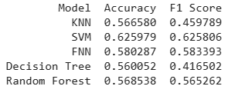
AI-Driven Eco-Friendly Email Management for Enhanced Productivity in the Automotive Industry
Models studied:
1 - K-Nearest Neighbors (K-NN) classifier
2 - Support Vector Machine classifier
3 - Forward Neural Network (FNN) classifier
4 - Decision Tree classifier
5 - Random Forest classifier
Path Forward: Synthetic data should be changed with real email data, to improve accuracy.
Notes:
Removing punctuation (Punctuation includes characters like periods, commas, question marks, exclamation points, and other symbols ) can help clean and simplify text data, making it easier to analyze and process

Slide 23
Two TIPs! 1. Email Ranking together with multi-classification can be adapted for individual Email -Boxes Condition: Individual email data should be used for training, 2. Machine learning models’ performance can be improved Condition: the size of the email set should increase regularly.
AI-Driven Eco-Friendly Email Management for Enhanced Productivity in the Automotive Industry

Slide 24

AI-Driven Eco-Friendly Email Management for Enhanced Productivity in the Automotive Industry
How it will help the client?
Ranking can help him prioritize
Save his time and money
He can forward his emails /
Jobseekers
Create an autoreply option for
non-urgent emails.
Improve Dr. David Woon's email management efficiency.
Implement a system to categorize emails
Reduce time spent on emails while maintaining effective communication.
Provide Dr. Woon with actionable insights to prioritize emails.
Address the potential cost issue if this email inefficiency scales to a larger workforce.
How it will help the Organization?
Customized product
HR emails may not be missed anymore
Improved productivity
has potential to save 31.25% salary /day.
DashBoard Info: raw.githack.com/venuannamdas/E_clean_AI/master/employee_wastage_map.html

Slide 25
AI-Driven Eco-Friendly Email Management for Enhanced Productivity in the Automotive Industry
Conlusions
What Email is a day-to-day requirement, people spend time differently on different emails. Urgency and segregation are two important aspects that need optimization.
How much 180 minutes of wastage a day by the employee. AI surely can customize brilliantly to guide the end-user towards productivity to minimise the loss of 31%.
Who Its not just for David woon, but can be used as assistant to various employees irrespective of heirarcy.
Additional Layer: this can be adopted as additional layer to their existing email services.
Statistics:
Wastage x Employee Population = 150 /60 x 217600 = 544,000 man-hrs
Max scope to save 31.25% per day = USD 700K with a modest salary of 4USD per hr (8 hr work a day)

Slide 26
AI-Driven Eco-Friendly Email Management for Enhanced Productivity in the Automotive Industry
15K can be saved (30-40 % saving initially)
4K can be saved (30-40 % saving initially)
As the AI model continues to train and test on new data (on-weekly or quarterly basis), has the potential to save 60-70%
Example: 8k and 25k saving at Brazil and Japan, respectively.

Slide 27
AI-Driven Eco-Friendly Email Management for Enhanced Productivity in the Automotive Industry
References
https://www.demandsage.com/how-many-emails-are-sent-per-day/
https://earthweb.com/how-many-emails-does-the-average-person-receive-per-day/#:~:text=billion%20by%202023.-,2.,by%20an%20average%20office%20worker
https://www.slicktext.com/blog/2019/06/survey-workplace-communication-statistics/#:~:text=Almost%20half%20(45.6%25)%20of,some%20emails%20in%20their%20inbox
https://www.digitalinformationworld.com/2023/01/people-spend-33-less-time-reading.html#:~:text=Back%20in%202018%2C%20studies%20showed,considered%20and%20taken%20into%20account
https://hbr.org/2019/01/how-to-spend-way-less-time-on-email-every-day#:~:text=The%20average%20professional%20spends%2028,120%20messages%20received%20per%20day
https://hbr.org/2019/01/how-to-spend-way-less-time-on-email-every-day#:~:text=The%20average%20professional%20spends%2028,120%20messages%20received%20per%20day
https://financesonline.com/email-statistics/
Acknowledgements
Safat
Eric
classmates

Slide 28
AI-Driven Eco-Friendly Email Management for Enhanced Productivity in the Automotive Industry
Thanks

Slide 29
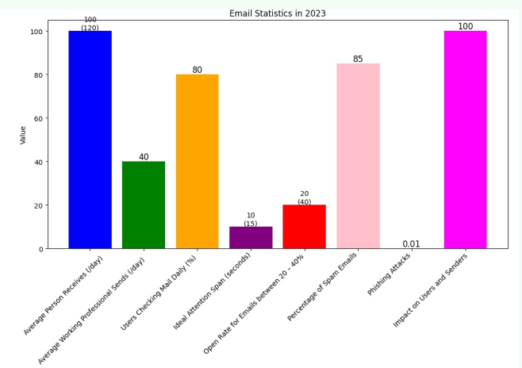
AI-Driven Eco-Friendly Email Management for Enhanced Productivity in the Automotive Industry
(Baseline Condition)
Dr. David Woon Email-box Status
High volume of emails >>> Global Average
Aims to reduce attention << Global Average
Existing basic Email organizer. → Effective in reducing Spam Emails by 85% → Ranking based on time of email sent/received
4. Inefficient use of time spent on emails (150 minutes daily).
5. Potential for significant cost implications if this problem scales to all the employees of the organization.

